Slide 1
AUTOMATING BUILDING DEPARTMENT PROCESSES
© 2019 the digit group, inc.

Slide 2
Dr. CB Amarnath
President
India Building Information Modeling Association (IBIMI)
Mr. Kausik Dutta
General Manager
Larsen & Toubro
Mr. Igor Starkov
CEO
EcoDomus
Paul Doherty, AIA, IFMA Fellow
Founder & Chairman
The Digit Group (TDG)

Slide 3
Smart Cities Development
Design | Construction | Operations
Innovation Development and Delivery
Housing | Transportation | Technology | Energy | Media
“Changing The World”
“An American Business Titan”
“Global Leader”
July 2018
November 2017
November 2017

Slide 4
Building Departments & Smart Cities

Slide 5
Business Model
United Nations Sustainable Development Goals to make our world more:
Prosperous • Inclusive • Sustainable • Resilient

Slide 6
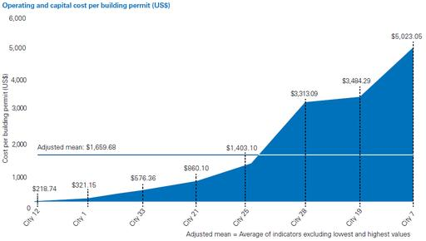
Building Permits – Worldwide Cost
Type of permit being issued
The level of complexity of the project
The complexity of the permit process and application
The level of digitization
Courtesy KPMG

Slide 7
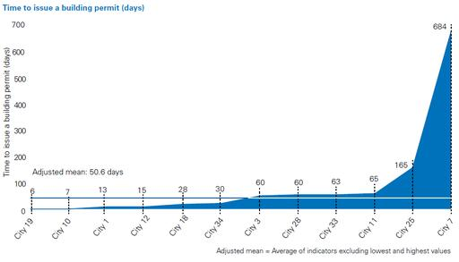
Building Permits – Worldwide Time
Managing rapid urban development and the associated increase in demand
Improving inter-sectorial and inter-agency coordination
Implementing new IT and back office systems
Reducing overall permit processing times
Increasing the number of permits approved upon initial application
Enhancing customer experience
Encouraging economic growth and Development
Courtesy KPMG

Slide 8
Building Department Innovations
In Brisbane, the Suburban Construction Management Team has used the new Planning Act and Environment Protection Act to adopt a stronger compliance focus, including training to facilitate the implementation of Prescribed Infringement Notices.
Authorities in Sao Paulo have implemented a new Electronic Licensing System (SLCe) that should allow projects to be approved in less than five working days by unifying documents within a single permit.
The city of Philadelphia introduced a new customer queuing system (that will enable customers to schedule appointments) and a new IT system that should allow customers to submit and pay for permits online.
Having split their applications into subcategories, authorities in Cape Town are now introducing electronic submissions and registering users as business partners with the city.
Courtesy KPMG

Slide 9
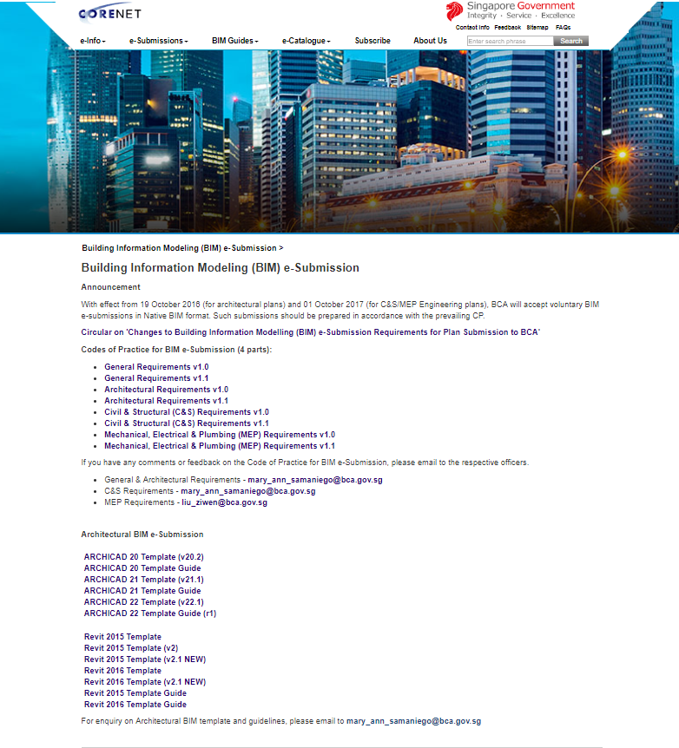
Singapore Corenet eSubmissions

Slide 10
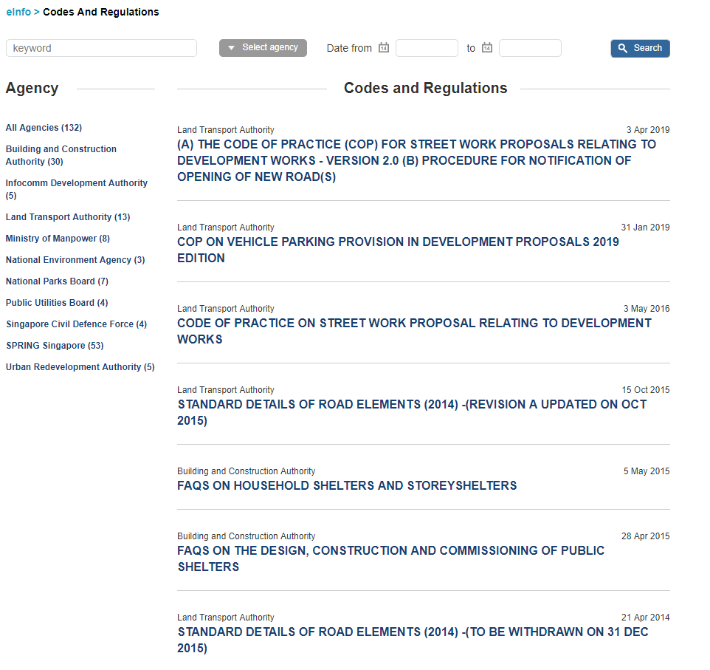
Singapore Corenet eResources

Slide 11
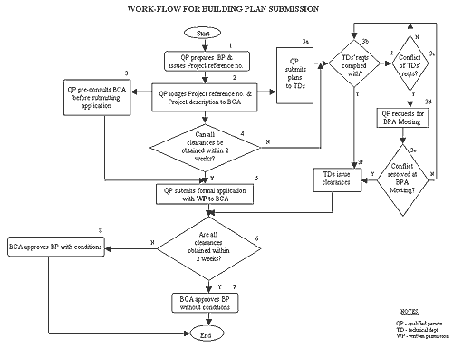
Singapore Building Plan Workflow

Slide 12
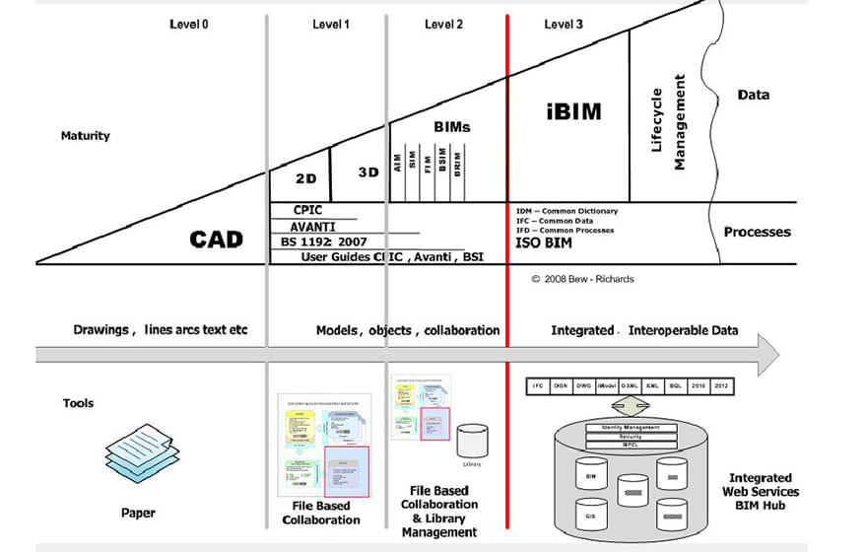
United Kingdom

Slide 13
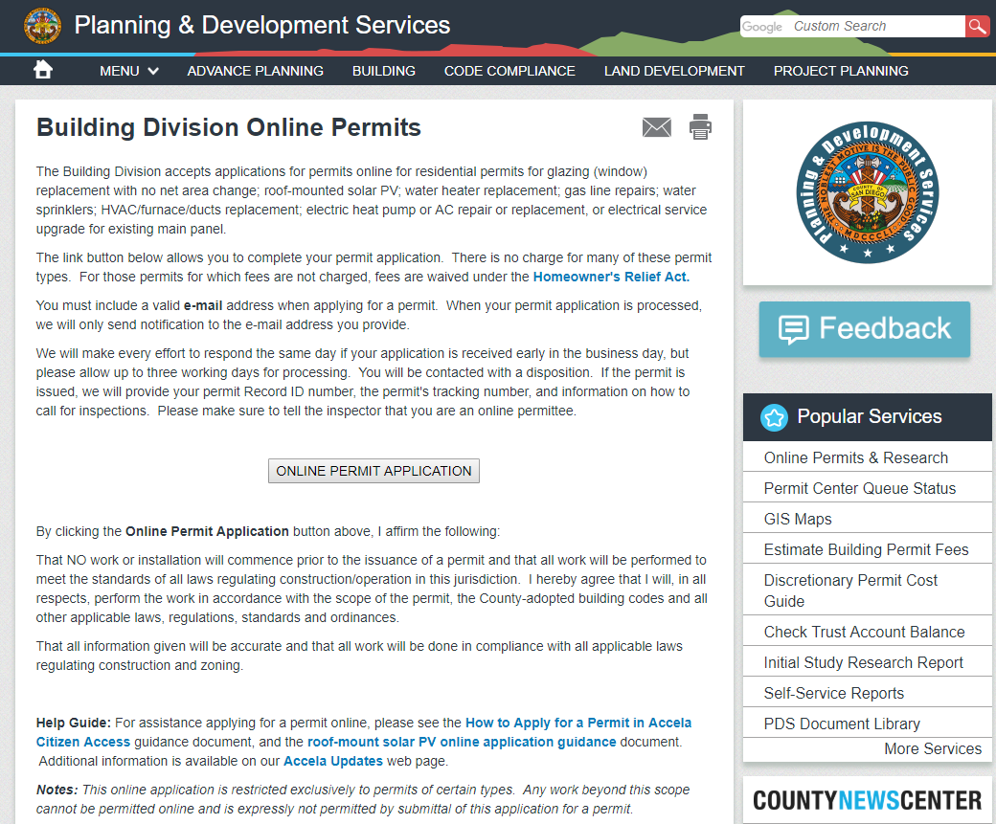
United States – San Diego, California

Slide 14
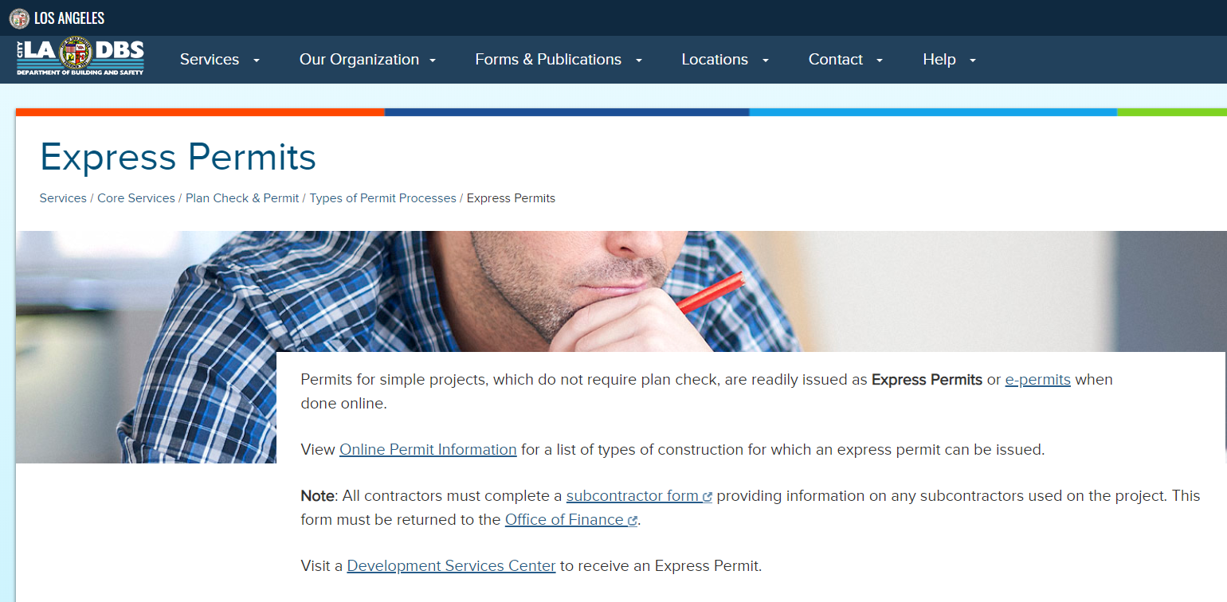
United States – Los Angeles, California

Slide 15
Beyond Permits
Standards for BIM Data
BIM LOD & IFC Failures
US – Digitized MasterFormat / Uniformat
Data Classification / Taxonomy / Common Language
U.S.- India
Common Language
Common Processes
Common Standards & Definitions
Increase Market Compatibility
Building Materials / Equipment / Appliances
Professional Services
Industry Industrialization
Do Not Develop Standards for Yesterday

Slide 16
Our Experts
Dr. CB Amarnath
President
India Building Information Modeling Association (IBIMI)
Mr. Kausik Dutta
General Manager
Larsen & Toubro
Mr. Igor Starkov
CEO
EcoDomus

Slide 17
SmartCities
www.thedigitgroup.com

